Slide 1
TIER Provisioning / Deprovisioning
Latent provisioning in (and around) TIER:
  Grouper
  COmanage
  MidPoint
TIER Provisioning Philosophies
  Functional overlap is ok – look for best fit in the environment
  Be pluggable and loosely coupled
  Be event / interface driven
  Look at authorization as grouping function
  Keep provisioning lightweight (and via standards where possible)

Slide 2
TIER – Data-Driven Authorization and Provisioning
basis:courses
ref:affiliations
app:canvas
Canvas Instance
Course Repository
Data-Driven Groups
Institutionally Meaningful Cohorts
Enterprise Access Control Policy
CS101
All Students
Canvas Students
CS102
CS Students
Canvas CS Students
CS 101 Students
Canvas CS 101 Students
ACCT101
Includes
CS 101 Course
Students
ACCT102
Excludes
Faculty
All Faculty
Canvas Faculty
Person Repository
MATH100
CS Faculty
Canvas CS Faculty
MATH102
CS 101 Faculty
Canvas CS 101 Faculty

Slide 3
TIER Provisioning Demo – SIS to Canvas via Grouper and Messaging
LDAP
Authentication
Shib IdP
SAML Attribute Release
Shib SP
Portal
memberOf query
SIS
Grouper
Loader
Grouper
Dynamic access control via memberOf attributes
Grouper REST Web Service Queries
Student / Course Data
AMQP Messages:
Group changes
Membership change
Shib SP
Canvas
RabbitMQ
Users, courses and enrollments populated via REST API
Change events
Canvas Provisioner
REST API

Slide 4
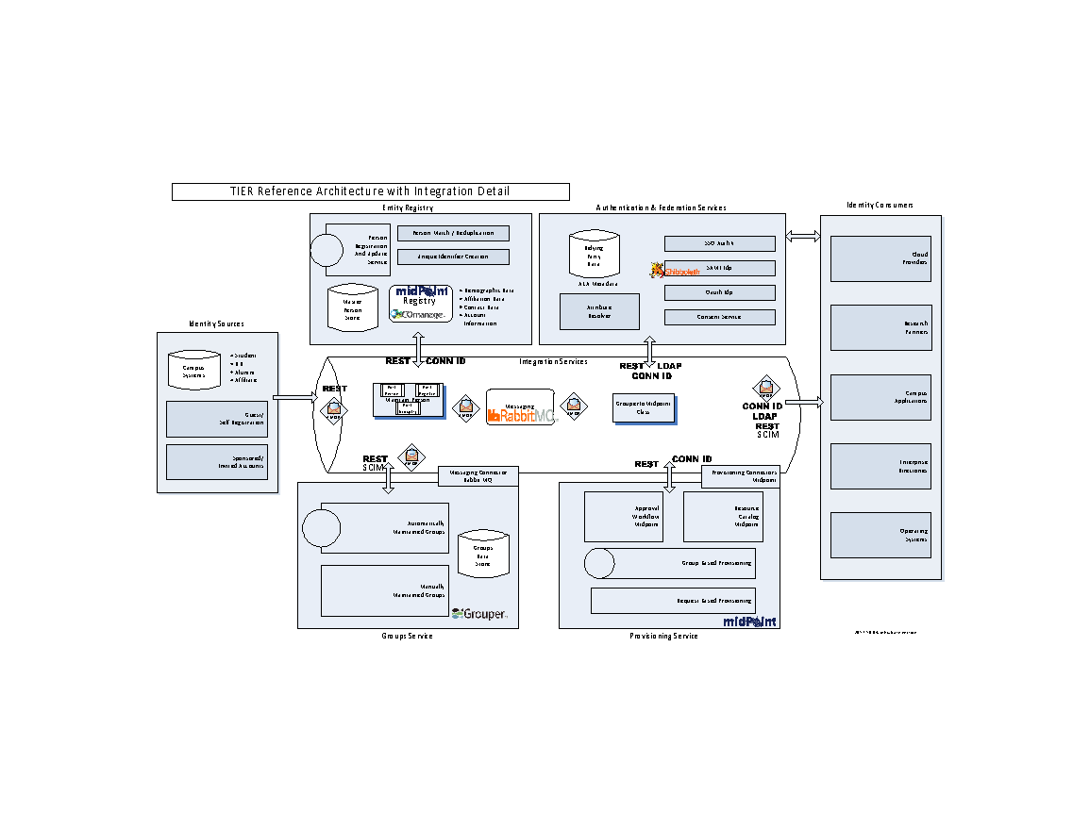
TIER Reference Architecture – Canvas Provisioning Demo
Shibboleth
Canvas
SIS
Grouper
Canvas Provisioner

